Slide 1
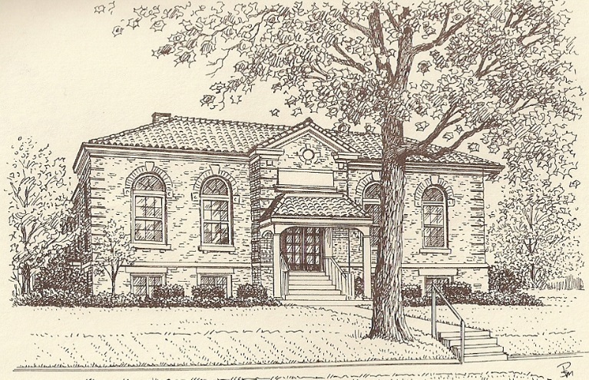
Computer Basics

Slide 2

The purpose of this class is to get comfortable with:
Using a computer
Using Windows

Slide 3

COMPUTER BASICS: We Will Discuss:
Parts of a computer ,
Turning on a computer,
Logging on,
Using the mouse, and
Using the keyboard.

Slide 4
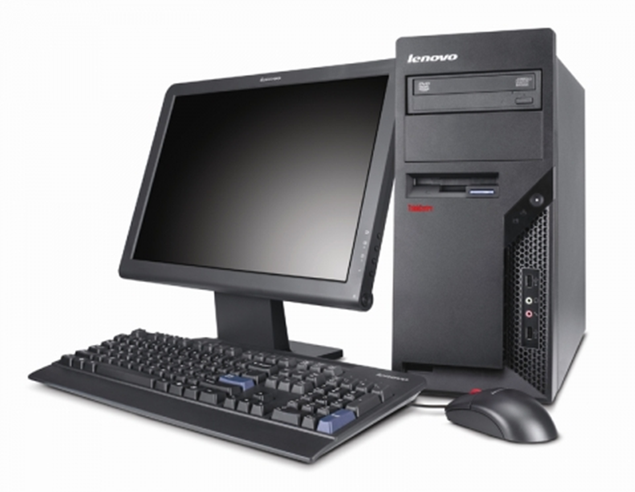
Remember
The computer is just a tool.

Slide 5




Like any other that you use on a daily basis…..

Slide 6
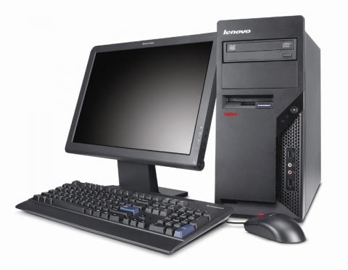
Parts of a Computer
System Unit
Monitor
1
2
Keyboard
Mouse
3
4

Slide 7
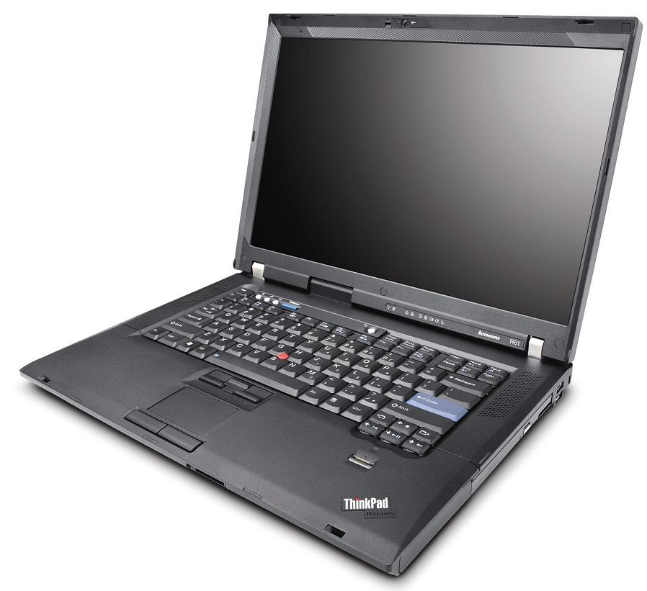
Activity - Parts of a computer
Monitor
1
Keyboard
2
3
Touch Pad

Slide 8

Turning On Computer
Power Buttons

Slide 9

Turning On Computer
Power Button
Tip: Do not use power button to turn off computer.
We will discuss the process for turning off your computer in the next section.

Slide 10
Activity - Turn On computer
Power Button

Slide 11
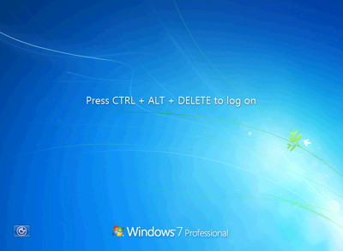
YOUR SCREEN SHOULD LOOK LIKE THIS!
Press and hold [Ctrl], then press and hold [Alt], and then press [Del]

Slide 12
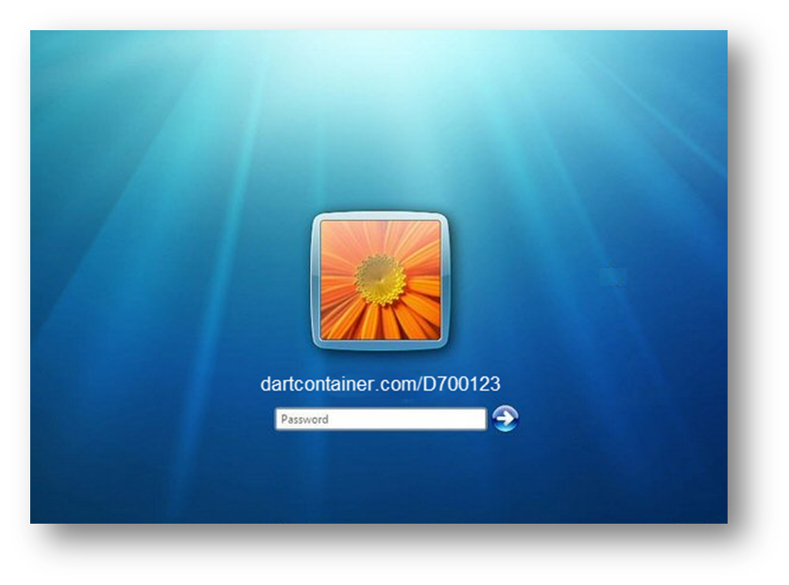
Activity - Logging On
Log on with Mas_train1a as the userID and password.

Slide 13
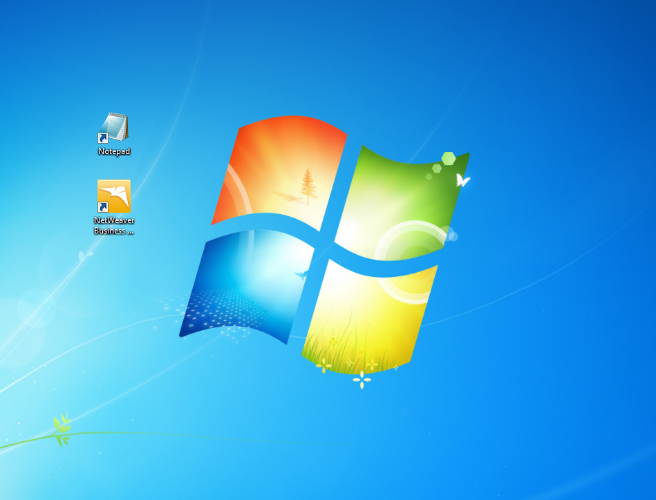
YOUR SCREEN SHOULD LOOK LIKE THIS
Tip: Use the same password for the computer, email, and SAP.

Slide 14
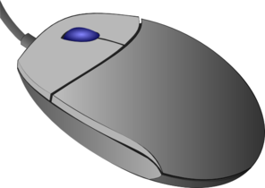
Using the Mouse

Slide 15
Using the Mouse
Left button
Use to Select Object

Slide 16
Using the Mouse
Right button
Use to Display a List of Choices

Slide 17
Using the Mouse
Scroll Wheel
Use to Scroll Up and Down a Page

Slide 18
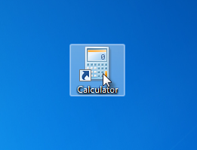
Activity – Selecting a Program
Click icon once with left button.
Tip: Click the icon image rather than the text.

Slide 19
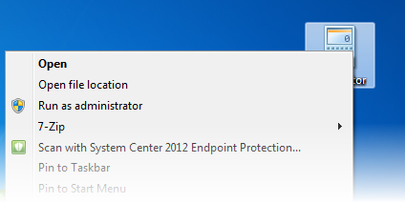
Activity – Displaying Program Options
Click icon once with right button.

Slide 20
Activity – Double Clicking to Open a Program
Double-click icon with left button.
Tip: Use two clicks in quick succession. It may take practice to get the timing right.

Slide 21
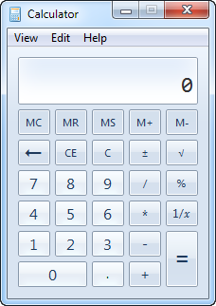
Activity - Using the mouse
- Using the Calculator Add the following
Add 123 plus 234 minus 10

Slide 22
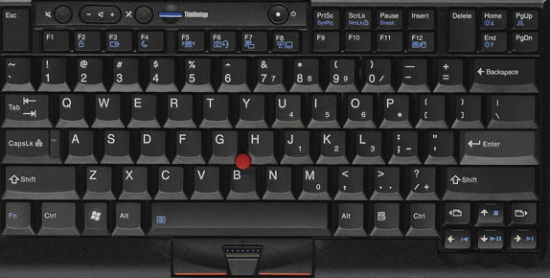
Using the Keyboard
Function Keys

Slide 23
Using the Keyboard
Alphanumeric Keys

Slide 24
Using the Keyboard
Directional Keys

Slide 25
Using the Keyboard
Backspace Key

Slide 26
Using the Keyboard
Delete Key

Slide 27
Using the Keyboard
Caps Lock Key

Slide 28
Using the Keyboard
Shift Key

Slide 29
Using the Keyboard
Enter Key

Slide 30
Using the Keyboard
Windows Key

Slide 31
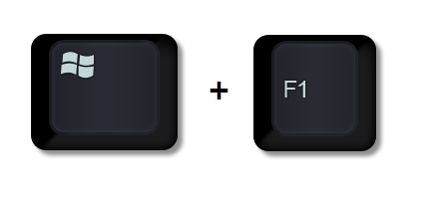
Shortcuts: Windows Help

Slide 32

Shortcuts: Lock Windows

Slide 33
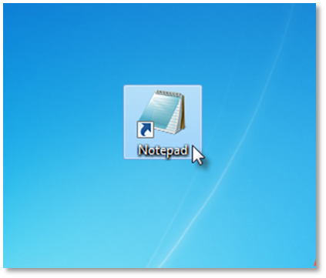
Activity – Using the Keyboard
Open Notepad

Slide 34
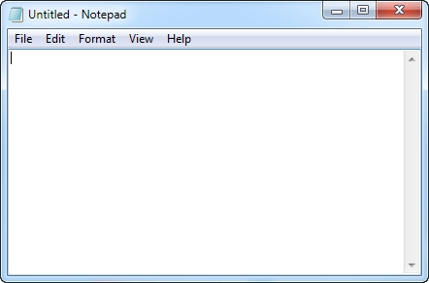
Activity - Using the keyboard
Type the Following Sentence:
I love my job!
Practice using the backspace, delete, and arrow keys.
Type the Following Sentence:
I REALLY LOVE MY JOB!

Slide 35


QUIZ: On Getting Started
Always use the Power button to turn on and off the computer.
True
False

Slide 36
QUIZ: On Getting Started
Click once with the left mouse button to select an item.
True
False

Slide 37
QUIZ: On Getting Started
The Windows key plus the L key allows you to lock your computer.
True
False

Slide 38
NAVIGATING WINDOWS: We Will Discuss
Desktop
Start Menu
Taskbar
Programs

Slide 39
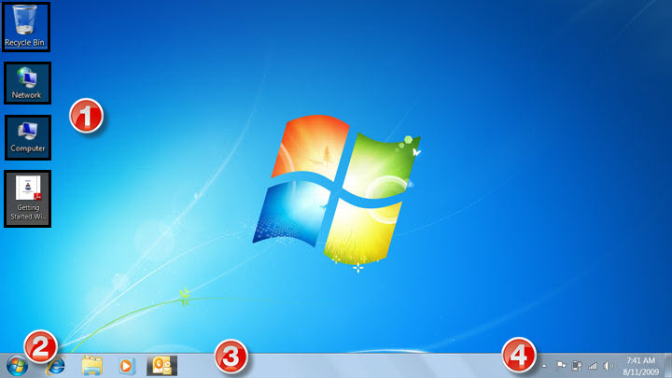
Navigating Windows: Desktop
1 Desktop/Icons | 2 Start Button
3 Taskbar | 4 Notification Area

Slide 40
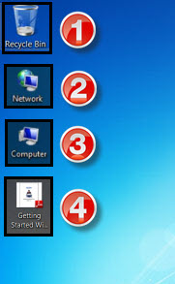
Navigating Windows: Desktop
1 Recycle Bin icon | 2 Network icon
3 Computer icon | 4 File Shortcut icon
All Icons on the Desktop are Shortcuts to Start a Commonly Used Programs or Open File Locations.

Slide 41
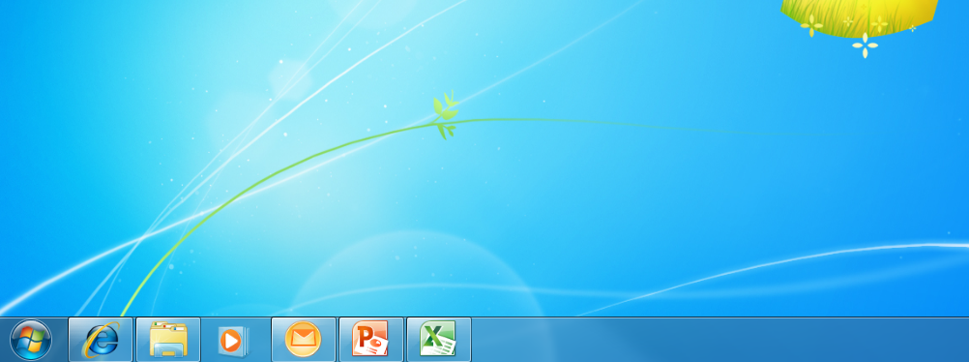
Navigating Windows: Taskbar
Taskbar Shows the Open Program.
To Access Programs on the Task Bar Simply Click Once to Re-Open

Slide 42
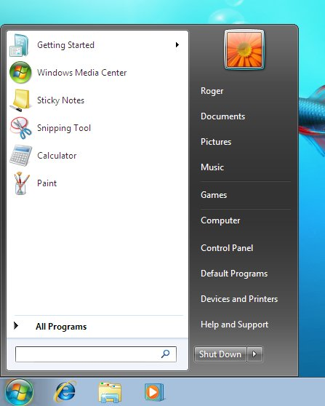
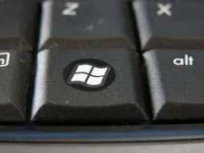
Navigating Windows: Start Button
From the Start Button You Can Open Programs and Shutdown Your Computer
TIP: You can also access the Start Menu by Pressing the
Windows Button

Slide 43

Navigating Windows: Opening a File or Program
How do you open a file or program?

Slide 44
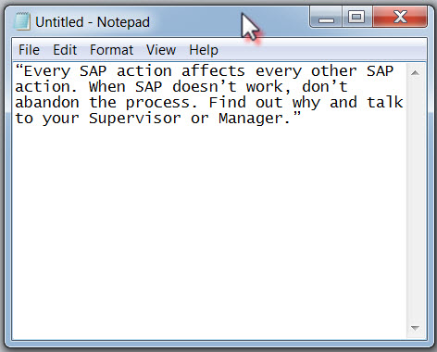
Navigating Windows: Ways Open Programs
Double Click on the Notepad Icon to Open, or Select Notepad from Start Menu, or Reopen from Taskbar.

Slide 45
Navigating Windows: Moving Program Window
How do you move a window?

Slide 46
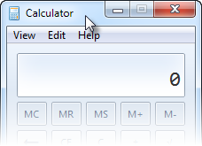
Activity – Moving Program Window
Click the left button and hold on Title bar. Drag mouse.

Slide 47
Navigating Windows: Resizing Program Window
How do you resize a window?

Slide 48
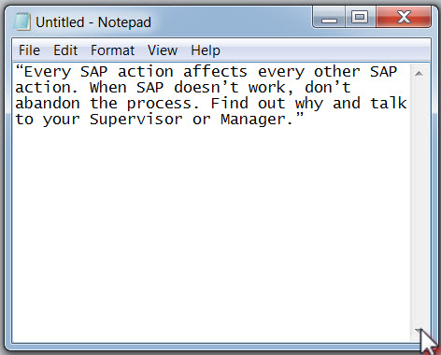


Navigating Windows: Changing Size
Minimizes the Program to the Task Bar
Resizes the Window to Full Screen from Partial Screen
Resizes the Window to Partial Screen from Full Screen

Slide 49
Navigating Windows: Closing Program Window
How do you close a window?

Slide 50
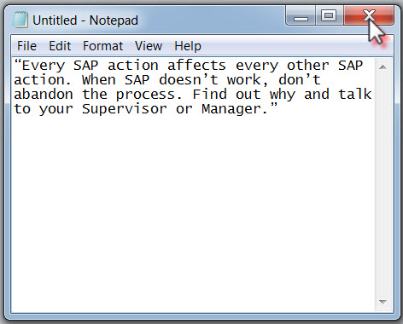
Navigating Windows: Close
Click on the Red “X” in the Top Right Hand Corner to Close a Program
TIP: Be Sure to Save Your Work Before You Close a Window. If You Do Not Save, You Will Lose Your Work.

Slide 51
Navigating Windows: Shutting Down the Computer
How do you shutdown your computer?

Slide 52
Activity: Shutting Down
Open the Start Menu
If you want to shut down, then click on Shut down

Slide 53
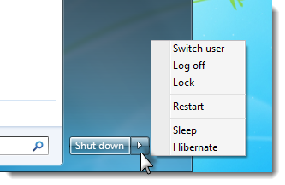
Activity: Shut Down Options
If you want to switch users, log off (but not shut down), lock the computer, or restart the computer, then click on the small arrow to the right of the Shut down icon and select the option you want

Slide 54
QUIZ: Navigating Windows
You can open files from
A. Desktop Shortcuts
B. Computer
C. Taskbar
D. All of the above

Slide 55
QUIZ: Navigating Windows
The Taskbar lets you view open programs.
True
False

Slide 56
QUIZ: Navigating Windows
You can only resize a window by dragging the lower right corner.
True
False

Slide 57
QUIZ: Navigating Windows
You can look for programs on the Start Menu.
True
False

Slide 58


